Slide 1
Software Architecture
New wine in old bottles?
(i.e., software architecture ≅ global design?,
architect ≅ designer)
Notes:
© SE, Architecture, Hans van Vliet
Is the notion of software architecture really important?

Slide 2

Overview
What is it, why bother?
Architecture Design
Viewpoints and view models
Architectural styles
Architecture asssessment
Role of the software architect
SE, Software Architecture, Hans van Vliet, ©2008
Notes:
© SE, Architecture, Hans van Vliet

Slide 3
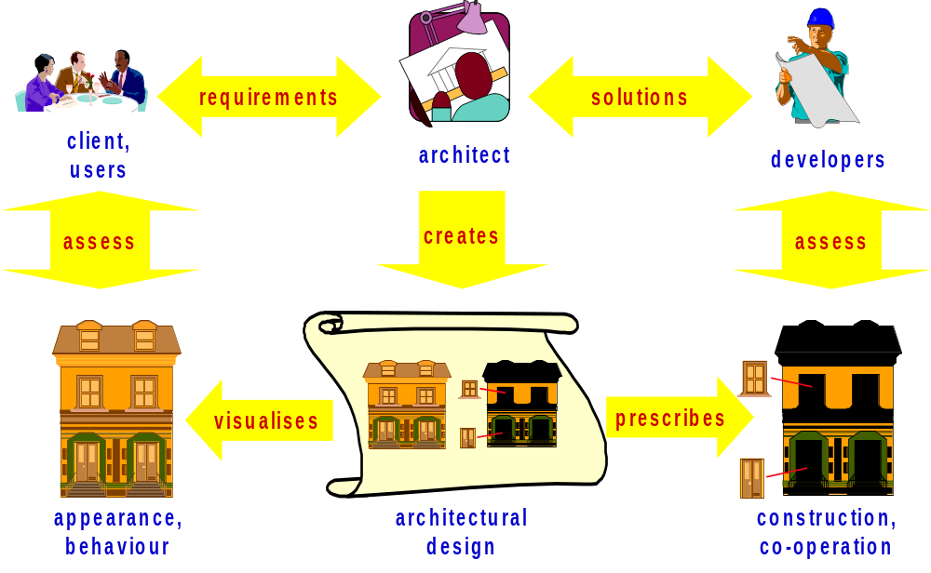
The Role of the Architect
SE, Software Architecture, Hans van Vliet, ©2008
Notes:
© SE, Architecture, Hans van Vliet
In a sense, the two elements on the lower left are new: the elements labeled appearance/behaviour, and the one labelled architectural design

Slide 4
Pre-architecture life cycle
stakeholders
(few)
requirements
quality
agreement
development
SE, Software Architecture, Hans van Vliet, ©2008
Notes:
© SE, Architecture, Hans van Vliet
Iteratie in dit model zit vooral in de requirements, en met slechts een paar stakeholders: onwerpers, opdrachtgever en gebruiker, met name.
Anzelfsprekend is er ook iteratie omdat bv kwaliteitskenmerken niet re realiseren zijn, eea te duur wordt, enz. Maar dat is vaak nadat de overeenkomst gesloten is.

Slide 5
Characteristics
Iteration mainly on functional requirements
Few stakeholders involved
No balancing of functional and quality requirements
SE, Software Architecture, Hans van Vliet, ©2008
Notes:
© SE, Architecture, Hans van Vliet

Slide 6
Adding architecture, the easy way
stakeholders
(few)
requirements
quality
agreement
architecture
detailed design
development
implementation
SE, Software Architecture, Hans van Vliet, ©2008
Notes:
© SE, Architecture, Hans van Vliet
Iteratie in dit model zit vooral in de requirements, en met slechts een paar stakeholders: onwerpers, opdrachtgever en gebruiker, met name.
Anzelfsprekend is er ook iteratie omdat bv kwaliteitskenmerken niet re realiseren zijn, eea te duur wordt, enz. Maar dat is vaak nadat de overeenkomst gesloten is.

Slide 7
Architecture in the life cycle
stakeholders
(many)
requirements
quality
architecture
agreement
development
SE, Software Architecture, Hans van Vliet, ©2008
Notes:
© SE, Architecture, Hans van Vliet

Slide 8
Characteristics
Iteration on both functional and quality requirements
Many stakeholders involved
Balancing of functional and quality requirements
SE, Software Architecture, Hans van Vliet, ©2008
Notes:
© SE, Architecture, Hans van Vliet
Hier valt natuurlijk nog veel meer over te zeggen, bv in relatie tot hergebruik, product lines, enz.

Slide 9

Why Is Architecture Important?
Architecture is the vehicle for stakeholder communication
Architecture manifests the earliest set of design decisions
  Constraints on implementation
  Dictates organizational structure
  Inhibits or enable quality attributes
Architecture is a transferable abstraction of a system
  Product lines share a common architecture
  Allows for template-based development
  Basis for training
SE, Software Architecture, Hans van Vliet, ©2008
Notes:
© SE, Architecture, Hans van Vliet
Vehicle: it is global, often graphical, often uses scenarios.
Early design decisions are important (cost of rework)
Means for planning and control: via the work breakdown structure which is derived from the architecture.
Transferable abstraction: architecture as a linguistic notion, as a basis for reuse, product lines, its use in traing people.

Slide 10

Where did it start?
1992: Perry & Wolf
1987: J.A. Zachman; 1989: M. Shaw
1978/79: David parnas, program families
1972 (1969): Edsger Dijkstra, program families
1969: I.P. Sharp @ NATO Software Engineering conference:
“I think we have something in addition to software engineering [..] This is the subject of software architecture. Architecture is different from engineering.”
SE, Software Architecture, Hans van Vliet, ©2008
Notes:
© SE, Architecture, Hans van Vliet
1992: Foundatins for the study of software architecture, Software Engineering Notes
1987: Zachman in IBM Systems Journal: Framework for Information Architecture
1989: Shaw , Larger Scale Systems require Higher Level Abstractions
1972: Dijkstra in Notes on Structured Programming, Note #10. This same text is also present in the proceedings of the 1969 SE conference
Intriguing question: What if the NATO conference was called Software Architecture?

Slide 11
Software architecture, definition (1)
The architecture of a software system defines that system in terms of computational components and interactions among those components.
(from Shaw and Garlan, Software Architecture, Perspectives on an Emerging Discipline, Prentice-Hall, 1996.)
SE, Software Architecture, Hans van Vliet, ©2008
Notes:
© SE, Architecture, Hans van Vliet

Slide 12
Software Architecture
statement
⇓
procedure
⇓
module
⇓
(design) pattern
⇓
architecture
SE, Software Architecture, Hans van Vliet, ©2008
Notes:
© SE, Architecture, Hans van Vliet
This is all about abstraction.
These abstractions first had a specific goal, and later turned into a notion of its own. E.g., procedures at first only served as a shorthand; memory was expensive, and people didn’t want to repeat the same sequence of instructions over and over again. Only later, did the notion of procedural abstraction evolve. Once people have discovered this broader notion, they can use it more effectively.
The same holds for the other abstraction notions, including patterns and architecture.

Slide 13
Software Architecture, definition (2)
The software architecture of a system is the structure or structures of the system, which comprise software elements, the externally visible properties of those elements, and the relationships among them.
(from Bass, Clements, and Kazman, Software Architecture in Practice, SEI Series in Software Engineering. Addison-Wesley, 2003.)
SE, Software Architecture, Hans van Vliet, ©2008
Notes:
© SE, Architecture, Hans van Vliet
Note: in edition 1, they talked about components, not elements.
Reason for change is that component has a rather (runtime) specific meanng within CBSE: a component is something that can be invoked/activated; but this line is not really followed throughout the book. Ergens verderop staat bv “component is a unit for reuse”

Slide 14
Software Architecture
Important issues raised in this definition:
  multiple system structures;
  externally visible (observable) properties of components.
The definition does not include:
  the process;
  rules and guidelines;
  architectural styles.
SE, Software Architecture, Hans van Vliet, ©2008
Notes:
© SE, Architecture, Hans van Vliet
Externally visible: so you are abstracting from something
architecture defines components; only their interaction counts, not their internals.
Every system has an architecture, and this architecture is not the same as its description (see also next IEEE definition)
Architecture can be good or bad: hence evaluation
Process: how do you get an architecture.
Rules: what should be/not be, in an architecture?

Slide 15
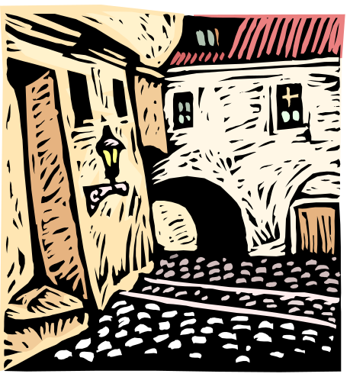
Architectural Structures
module structure
conceptual, or logical structure
process, or coordination structure
physical structure
uses structure
calls structure
data flow
control flow
class structure
SE, Software Architecture, Hans van Vliet, ©2008
Notes:
© SE, Architecture, Hans van Vliet
Module structure: static, aimed at the implementation
Open question: what is the relation between structures?
Later on, in IEEE, and by now generally accepted, these structures are called viewpoints.

Slide 16
Software Architecture, definition (3)
Architecture is the fundamental organization of a system embodied in its components, their relationships to each other and to the environment and the principles guiding its design and evolution
(from IEEE Standard on the Recommended Practice for Architectural Descriptions, 2000.)
SE, Software Architecture, Hans van Vliet, ©2008
Notes:
© SE, Architecture, Hans van Vliet

Slide 17
Software Architecture
Architecture is conceptual.
Architecture is about fundamental things.
Architecture exists in some context.
SE, Software Architecture, Hans van Vliet, ©2008
Notes:
© SE, Architecture, Hans van Vliet
The architectural descriptions are concrete, but the architecture itself is ingherently conceptual, and cannot be captured in any (set of) views.
Fundamental: so you concentrate on the important things, and abstract from the rest.
An architecture does not exist in the abstract, but always in some context. We can only understand its qualities in its context.

Slide 18
Other points of view
Architecture is high-level design
Architecture is overall structure of the system
Architecture is the structure, including the principles and guidelines governing their design and evolution over time
Architecture is components and connectors
SE, Software Architecture, Hans van Vliet, ©2008

Slide 19
Software Architecture & Quality
The notion of quality is central in software architecting: a software architecture is devised to gain insight in the qualities of a system at the earliest possible stage.
Some qualities are observable via execution: performance, security, availability, functionality, usability
And some are not observable via execution: modifiability, portability, reusability, integrability, testability
SE, Software Architecture, Hans van Vliet, ©2008
Notes:
© SE, Architecture, Hans van Vliet

Slide 20
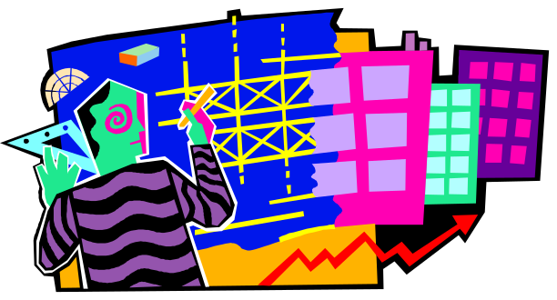
Overview
What is it, why bother?
Architecture Design
Viewpoints and view models
Architectural styles
Architecture asssessment
Role of the software architect
SE, Software Architecture, Hans van Vliet, ©2008
Notes:
© SE, Architecture, Hans van Vliet

Slide 21
Attribute-Driven Design (Bass et al, Ch 7)
Choose module to decompose
Refine this module:
  choose architectural drivers (quality is driving force)
  choose pattern that satisfies drivers
  apply pattern
Repeat steps
SE, Software Architecture, Hans van Vliet, ©2008
Notes:
© SE, Architecture, Hans van Vliet
ADD takes as input a set of quality attribute scenarios (source, stimulus, etc), and employs knowledge about relation between quality and architectural patterns that achieve it.

Slide 22
Example ADD iterations
Top-level: usability ⇒ separate user interface ⇒ Seeheim/three tier architecture
Lower-level, within user interface: security ⇒ authenticate users
Lower-level, within data layer: availability ⇒ active redundancy
SE, Software Architecture, Hans van Vliet, ©2008
Notes:
© SE, Architecture, Hans van Vliet

Slide 23
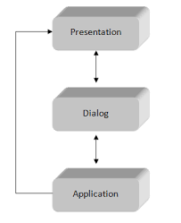
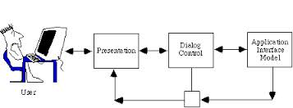
Example ADD iterations
SE, Software Architecture, Hans van Vliet, ©2008
Notes:
© SE, Architecture, Hans van Vliet

Slide 24
Example ADD iterations
The Seeheim models describes the user interface as the outer layer of the system.
  Presentation – perceptible aspects including screen design and keyboard layout.
  Dialog – syntax of the interaction including metacommunication (help functions, error messages, and state information.)
SE, Software Architecture, Hans van Vliet, ©2008
Notes:
© SE, Architecture, Hans van Vliet

Slide 25
Generalized model
Understand problem
Solve it
Evaluate solution
SE, Software Architecture, Hans van Vliet, ©2008
Notes:
© SE, Architecture, Hans van Vliet

Slide 26
Global workflow in architecture design
synthesis
architecture
context
backlog
evaluation
requirements
evaluation
results
SE, Software Architecture, Hans van Vliet, ©2008
Notes:
© SE, Architecture, Hans van Vliet

Slide 27
Generalized model (cont’d)
assets
architecture
ideas
synthesis
backlog
evaluation
constraints
eval results
sign.reqs
SE, Software Architecture, Hans van Vliet, ©2008
Notes:
© SE, Architecture, Hans van Vliet

Slide 28

Overview
What is it, why bother?
Architecture Design
Viewpoints and view models
Architectural styles
Architecture asssessment
Role of the software architect
SE, Software Architecture, Hans van Vliet, ©2008
Notes:
© SE, Architecture, Hans van Vliet

Slide 29
Analogy with building architecture
Overall picture of building (client)
Front view (client, “beauty” committee)
Separate picture for water supply (plumber)
Separate picture for electrical wiring (electrician)
etc
SE, Software Architecture, Hans van Vliet, ©2008
Notes:
© SE, Architecture, Hans van Vliet

Slide 30
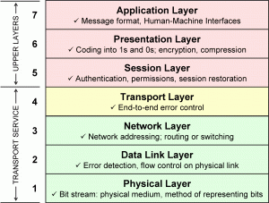
SE, Software Architecture, Hans van Vliet, ©2008
Notes:
© SE, Architecture, Hans van Vliet

Slide 31
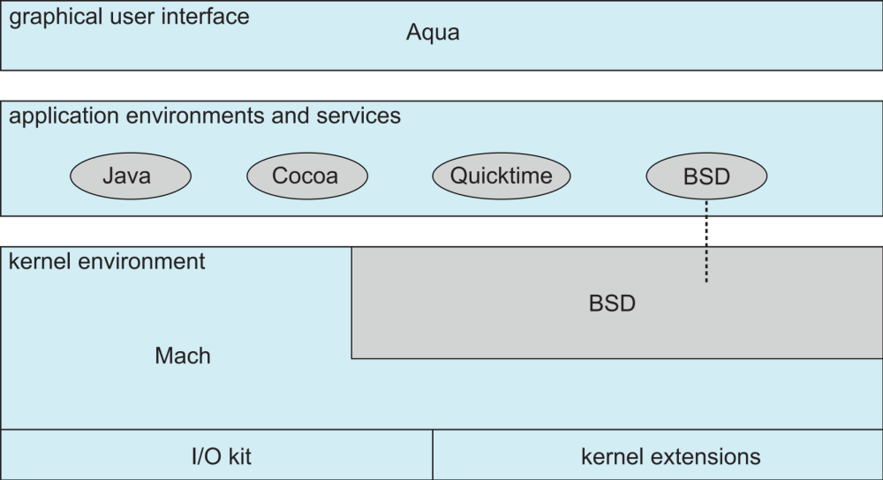
SE, Software Architecture, Hans van Vliet, ©2008
Notes:
© SE, Architecture, Hans van Vliet

Slide 32
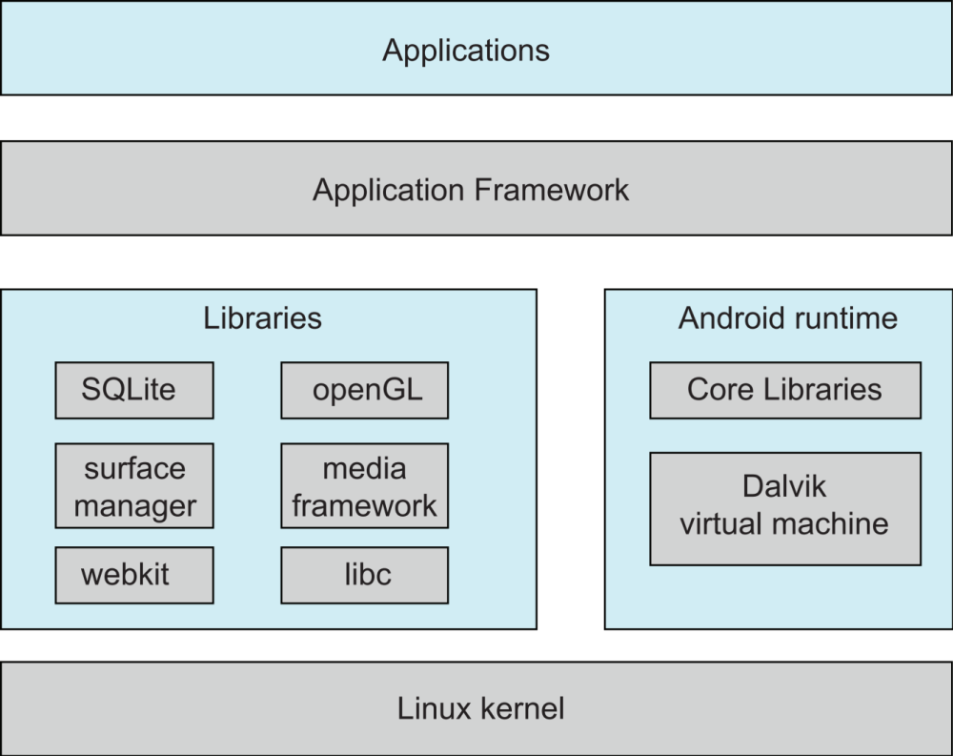
SE, Software Architecture, Hans van Vliet, ©2008
Notes:
© SE, Architecture, Hans van Vliet

Slide 33
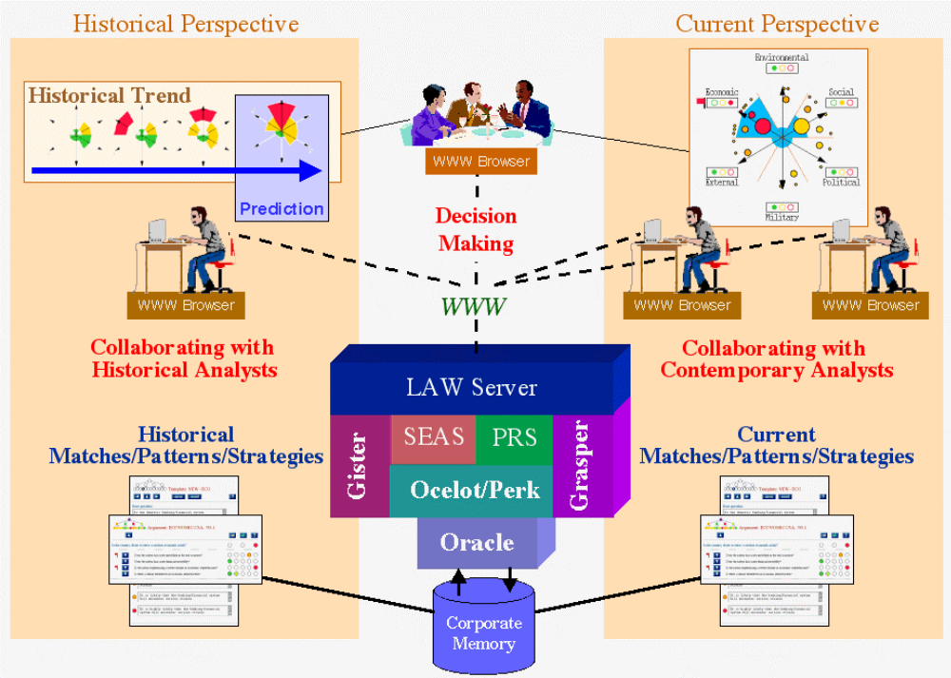
SE, Software Architecture, Hans van Vliet, ©2008
Notes:
© SE, Architecture, Hans van Vliet

Slide 34
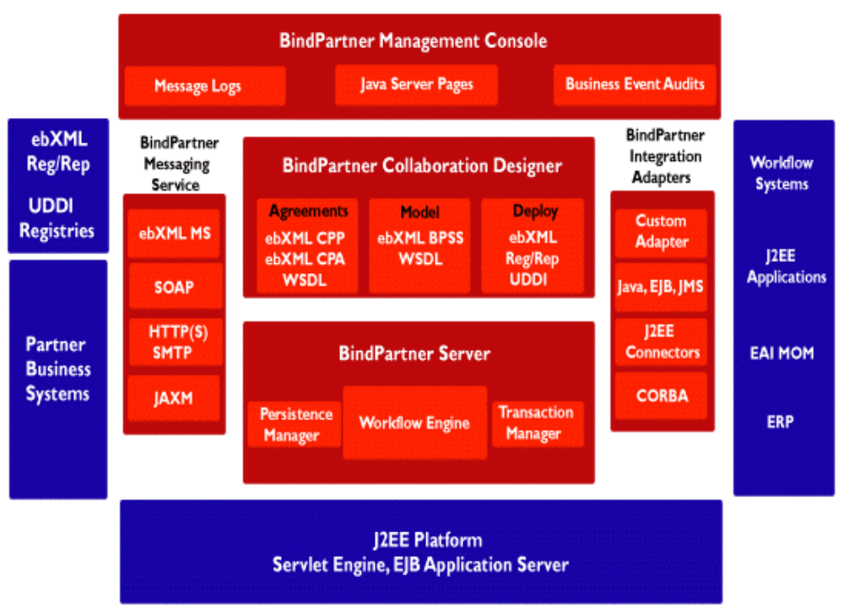
SE, Software Architecture, Hans van Vliet, ©2008
Notes:
© SE, Architecture, Hans van Vliet

Slide 35
Some terms (from IEEE standard)
System stakeholder: an individual, team, or organization (or classes hereof) with interests in, or concerns relative to, a system.
View: a representation of a whole system from the perspective of a related set of concerns.
Viewpoint: A viewpoint establishes the purposes and audience for a view and the techniques or methods employed in constructing a view.
SE, Software Architecture, Hans van Vliet, ©2008
Notes:
© SE, Architecture, Hans van Vliet

Slide 36
Stakeholders
Architect
Requirements engineer
Designer (also of other systems)
Implementor
Tester, integrator
Maintainer
Manager
Quality assurance people
SE, Software Architecture, Hans van Vliet, ©2008
Notes:
© SE, Architecture, Hans van Vliet
Hier gaat het om hun communication needs (p 204).
Architect: negotiates, makes tade-offs
Reqs engineer: idem
Designer: resolve issues, bv rond resource consumption, performance issues
Implementor: constraints and freedoms richting downstream activities.
Tester, integrator: correct black-box behavior of parts.
Maintainer: areas a prospective change will affect.
Manager: maken development team, assign tasks, plan resources, track progress.
QA: basis for conformance checking

Slide 37
Architectural views (view = representation of a structure)
Module views
  Module is unit of implementation
  Decomposition, uses, layered, class
Component and connector (C & C) views
  These are runtime elements
  Process (communication), concurrency, shared data (repository), client-server
Allocation views
  Relationship between software elements and environment
  Work assignment, deployment, implementation
SE, Software Architecture, Hans van Vliet, ©2008
Notes:
© SE, Architecture, Hans van Vliet

Slide 38
How to decide on which viewpoints
What are the stakeholders and their concerns?
Which viewpoints address these concerns?
Prioritize and possibly combine viewpoints
SE, Software Architecture, Hans van Vliet, ©2008
Notes:
© SE, Architecture, Hans van Vliet
Bv via het maken van een stakeholder/view list. Geef aan hoeveel uit elke vew de stakeholders nodig hebben.
Vaak zul je views willen combineren, want je wilt er geen 12 maken. (bv module decomposition and implementation view kun je vaak combineren. Of module decomposition en layered of uses).

Slide 39
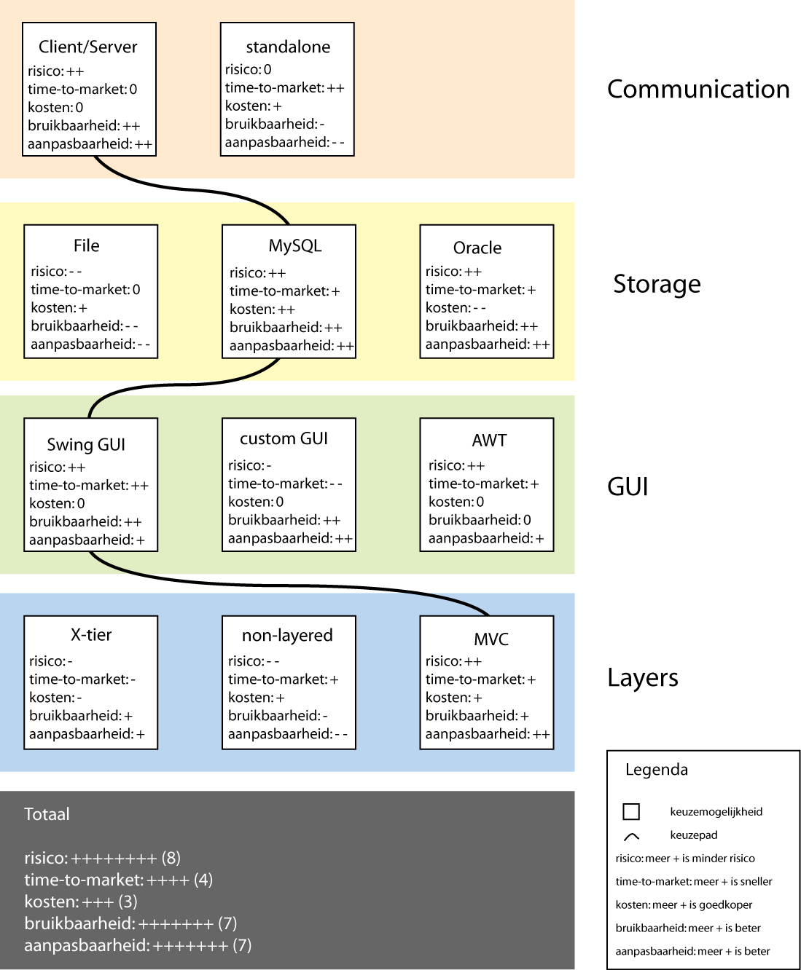
Business viewpoint
SE, Software Architecture, Hans van Vliet, ©2008
Notes:
© SE, Architecture, Hans van Vliet

Slide 40

Overview
What is it, why bother?
Architecture Design
Viewpoints and view models
Architectural styles
Architecture asssessment
Role of the software architect
SE, Software Architecture, Hans van Vliet, ©2008
Notes:
© SE, Architecture, Hans van Vliet

Slide 41
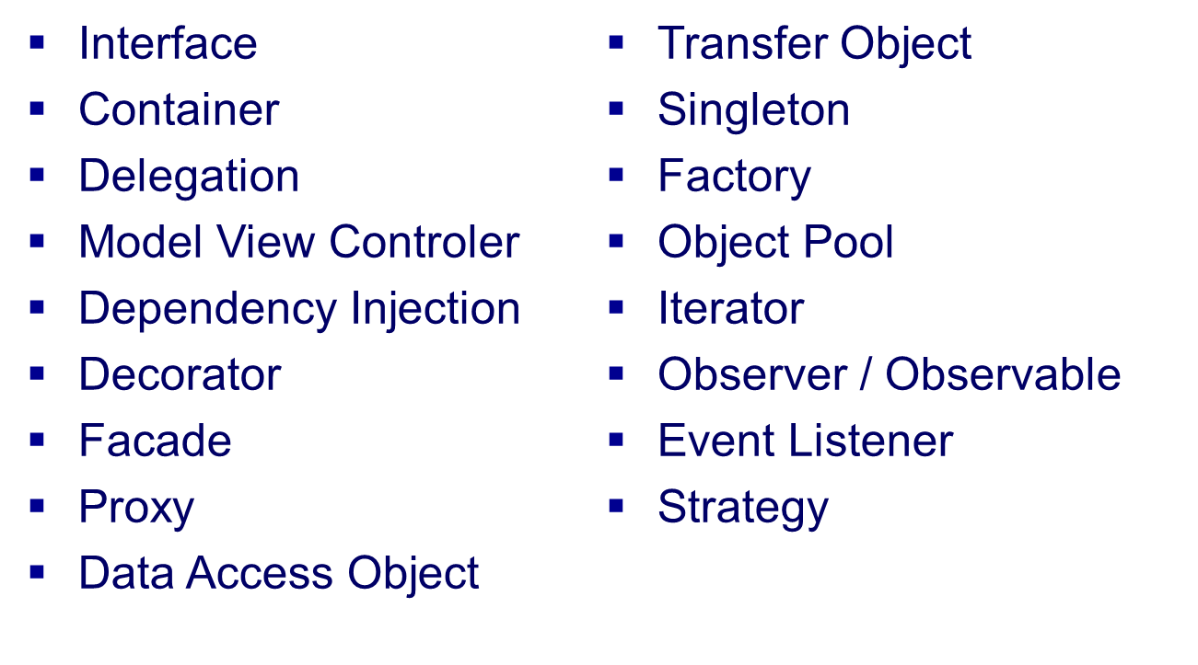
Architecture/Design Patten
SE, Software Architecture, Hans van Vliet, ©2008
Notes:
© SE, Architecture, Hans van Vliet

Slide 42
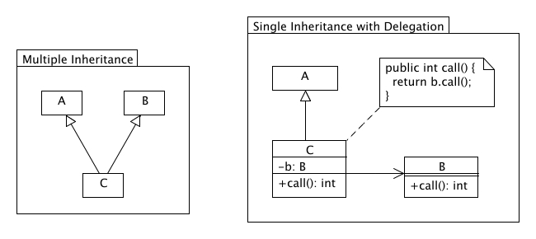
Architecture/Design Patten
Deligation
SE, Software Architecture, Hans van Vliet, ©2008
Notes:
© SE, Architecture, Hans van Vliet

Slide 43
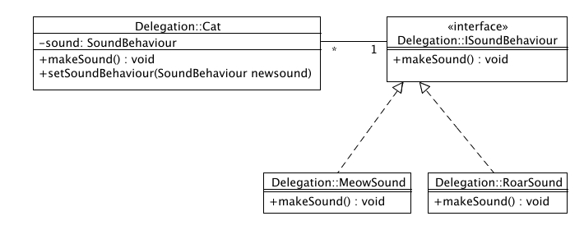
Architecture/Design Patten
Deligation
SE, Software Architecture, Hans van Vliet, ©2008
Notes:
© SE, Architecture, Hans van Vliet

Slide 44
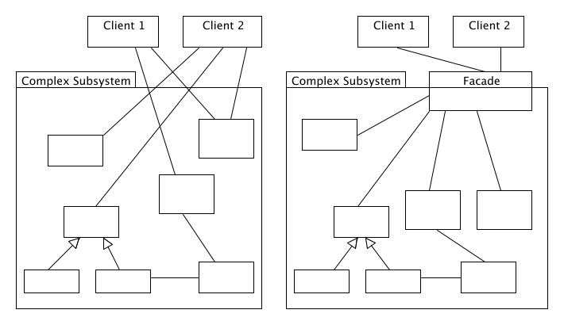
Architecture/Design Patten
Facade
SE, Software Architecture, Hans van Vliet, ©2008
Notes:
© SE, Architecture, Hans van Vliet

Slide 45
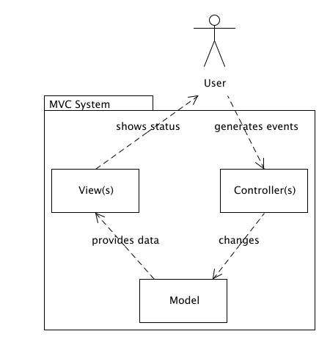
Architecture/Design Patten
Model View
Controller
SE, Software Architecture, Hans van Vliet, ©2008
Notes:
© SE, Architecture, Hans van Vliet

Slide 46
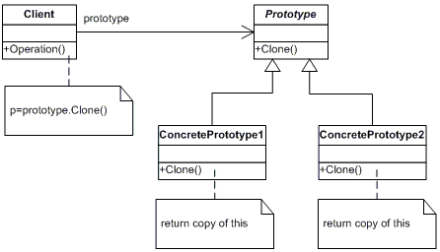
Architecture/Design Patten
Prototype
SE, Software Architecture, Hans van Vliet, ©2008
Notes:
© SE, Architecture, Hans van Vliet

Slide 47
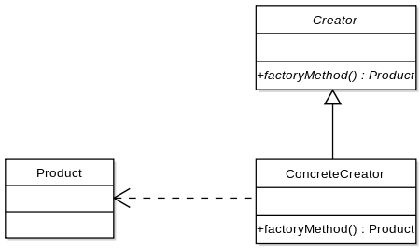
Architecture/Design Patten
Factory/Factory Method
SE, Software Architecture, Hans van Vliet, ©2008
Notes:
© SE, Architecture, Hans van Vliet

Slide 48
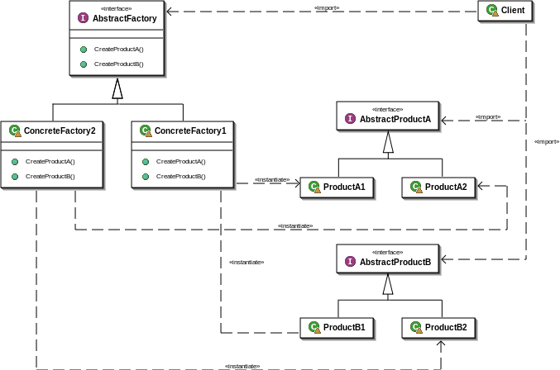
Architecture/Design Patten
Factory/Factory Method
SE, Software Architecture, Hans van Vliet, ©2008
Notes:
© SE, Architecture, Hans van Vliet

Slide 49
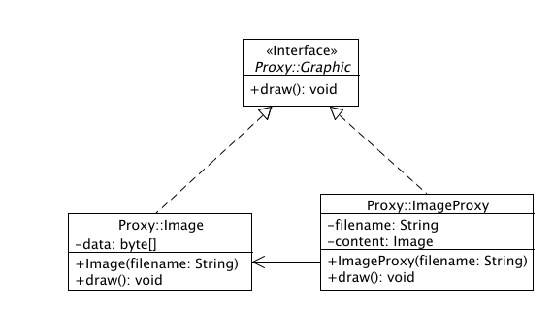
Architecture/Design Patten
Proxy
SE, Software Architecture, Hans van Vliet, ©2008
Notes:
© SE, Architecture, Hans van Vliet

Slide 50
Architecture/Design Patten
Design Pattern Catalog
  Crearional Patterns
  Structural Patterns
  Behavial Patterns
SE, Software Architecture, Hans van Vliet, ©2008
Notes:
© SE, Architecture, Hans van Vliet

Slide 51
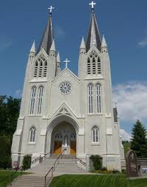
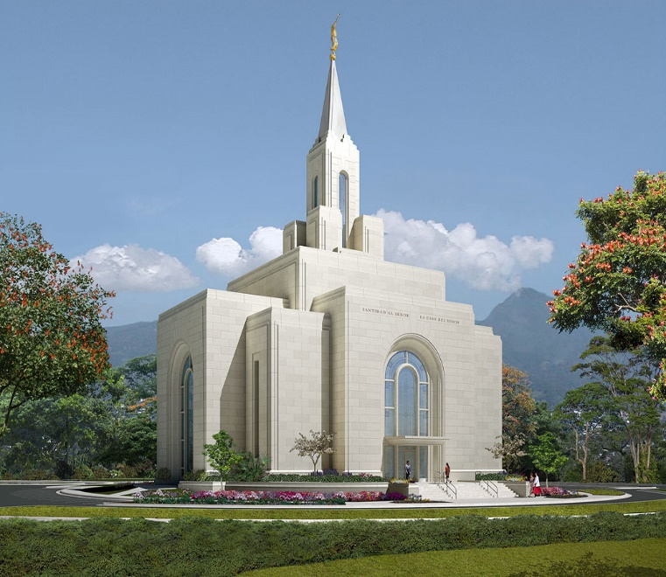
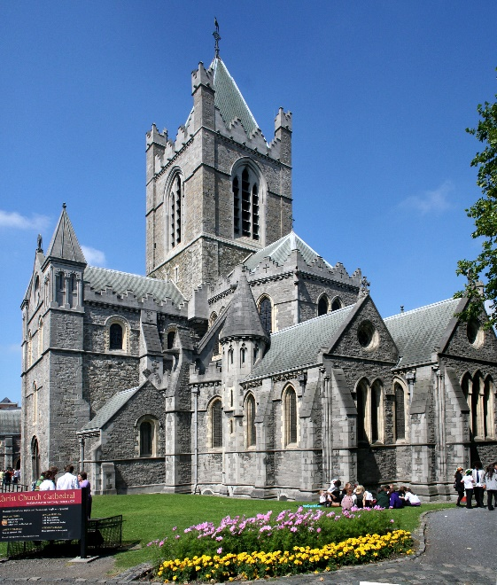

Style
SE, Software Architecture, Hans van Vliet, ©2008

Slide 52
Architectural styles
An architectural style is a description of component and connector types and a pattern of their runtime control and/or data transfer.
Examples:
  main program with subroutines
  data abstraction
  implicit invocation
  pipes and filters
  repository (blackboard)
  layers of abstraction
SE, Software Architecture, Hans van Vliet, ©2008
Notes:
© SE, Architecture, Hans van Vliet

Slide 53
Components and Connectors
Components are connected by connectors.
They are the building blocks with which an architecture can be described.
No standard notation has emerged yet.
SE, Software Architecture, Hans van Vliet, ©2008
Notes:
© SE, Architecture, Hans van Vliet

Slide 54
Types of components
computational: does a computation of some sort. E.g. function, filter.
memory: maintains a collection of persistent data. E.g. data base, file system, symbol table.
manager: contains state + operations. State is retained between invocations of operations. E.g. adt, server.
controller: governs time sequence of events. E.g. control module, scheduler.
SE, Software Architecture, Hans van Vliet, ©2008
Notes:
© SE, Architecture, Hans van Vliet

Slide 55
Types of connectors
procedure call (including RPC)
data flow (e.g. pipes)
implicit invocation
message passing
shared data (e.g. blackboard or shared data base)
instantiation
SE, Software Architecture, Hans van Vliet, ©2008
Notes:
© SE, Architecture, Hans van Vliet

Slide 56
Main-program-with-subroutines style
problem: hierarchy of functions; result of functional decomposition, single thread of control
context: language with nested procedures
solution:
  system model: modules in a hierarchy, may be weak or strong, coupling/cohesion arguments
  components: modules with local data, as well as global data
  connectors: procedure call
  control structure: single thread, centralized control: main program pulls the strings
variants: OO versus non-OO
SE, Software Architecture, Hans van Vliet, ©2008
Notes:
© SE, Architecture, Hans van Vliet

Slide 57
Abstract-data-type style
problem: identify and protect related bodies of information. Data representations likely to change.
context: OO-methods which guide the design, OO-languages which provide the class-concept
solution:
  system model: component has its own local data (= secret it hides)
  components: managers (servers, objects, adt’s)
  connectors: procedure call (message)
  control structure: single thread, usually; control is decentralized
variants: caused by language facilities
SE, Software Architecture, Hans van Vliet, ©2008
Notes:
© SE, Architecture, Hans van Vliet

Slide 58
Implicit-invocation style
problem: loosely coupled collection of components. Useful for applications which must be reconfigurable.
context: requires event handler, through OS or language.
solution:
  system model: independent, reactive processes, invoked when an event is raised
  components: processes that signal events and react to events
  connectors: automatic invocation
  control structure: decentralized control. Components do not know who is going to react.
variants: Tool-integration frameworks, and languages with special features.
SE, Software Architecture, Hans van Vliet, ©2008
Notes:
© SE, Architecture, Hans van Vliet

Slide 59
Pipes-and-filters style
problem: independent, sequential transformations on ordered data. Usually incremental, Ascii pipes.
context: series of incremental transformations. OS-functions transfer data between processes. Error-handling difficult.
solution:
  system model: continuous data flow; components incrementally transform data
  components: filters for local processing
  connectors: data streams (usually plain ASCII)
  control structure: data flow between components; component has own flow
variants: From pure filters with little internal state to batch processes
SE, Software Architecture, Hans van Vliet, ©2008
Notes:
© SE, Architecture, Hans van Vliet

Slide 60
Repository style
Client
Client
Shared Data
Client
problem: manage richly structured information, to be manipulated in many different ways. Data is long-lived.
context: shared data to be acted upon by multiple clients
solution:
  system model: centralized body of information. Independent computational elements.
  components: one memory, many computational
  connectors: direct access or procedure call
  control structure: varies, may depend on input or state of computation
variants: traditional data base systems, compilers, blackboard systems
SE, Software Architecture, Hans van Vliet, ©2008
Notes:
© SE, Architecture, Hans van Vliet

Slide 61
Layered style
Layer_{n}
Layer₂
Layer₁
problem: distinct, hierarchical classes of services. “Concentric circles” of functionality
context: a large system that requires decomposition (e.g., virtual machines, OSI model)
solution:
  system model: hierarchy of layers, often limited visibility
  components: collections of procedures (module)
  connectors: (limited) procedure calls
  control structure: single or multiple threads
variants: relaxed layering
SE, Software Architecture, Hans van Vliet, ©2008
Notes:
© SE, Architecture, Hans van Vliet

Slide 62
Model-View-Controller (MVC) style
Controller
View
n
n
Model
problem: separation of UI from application is desirable due to expected UI adaptations
context: interactive applications with a flexible UI
solution:
  system model: UI (View and Controller Component(s)) is decoupled from the application (Model component)
  components: collections of procedures (module)
  connectors: procedure calls
  control structure: single thread
variants: Document-View
SE, Software Architecture, Hans van Vliet, ©2008
Notes:
© SE, Architecture, Hans van Vliet

Slide 63

Overview
What is it, why bother?
Architecture Design
Viewpoints and view models
Architectural styles
Architecture asssessment
Role of the software architect
SE, Software Architecture, Hans van Vliet, ©2008
Notes:
© SE, Architecture, Hans van Vliet

Slide 64
Architecture evaluation/analysis
Assess whether architecture meets certain quality goals, such as those w.r.t. maintainability, modifiability, reliability, performance
Mind: the architecture is assessed, while we hope the results will hold for a system yet to be built
SE, Software Architecture, Hans van Vliet, ©2008
Notes:
© SE, Architecture, Hans van Vliet

Slide 65
Software Architecture Analysis
Software
architecture
implementation
System
properties
Qualities
Properties
SE, Software Architecture, Hans van Vliet, ©2008
Notes:
© SE, Architecture, Hans van Vliet
Je “test” dus die properties, en je hoopt dat, als het systeem eenmaal geimlementeerd is, dat systeem de betreffende kwaliteitseigenschappen zal hebben.

Slide 66
Summary
new and immature field
proliferation of terms: architecture - design pattern - framework - idiom
architectural styles and design pattern describe (how are things done) as well as prescribe (how should things be done)
stakeholder communication
early evaluation of a design
transferable abstraction
SE, Software Architecture, Hans van Vliet, ©2008
Notes:
© SE, Architecture, Hans van Vliet

